Slide 1
VLSI Test Principles and Architectures
Chapter 8, Memory Testing and Built-In Self-Test
Haochen Ding

Slide 2
INTRODUCTION
00

Slide 3
00 Introduction
Memory testers for full qualification and testing of embedded DRAM (EDRAM) will be much more expensive.
With BIST, the tester requirement for EDRAM can be minimized, and memory tester time can be greatly reduced throughout the entire test flow of the EDRAM.
It is also a good approach to protecting intellectual property.

Slide 4
00 Introduction – Contents of This Chapter
01 RAM Functional Fault Models and Test Algorithms
02 RAM Fault Simulation and Test Algorithm Generation
03 Memory Built-In Self-Test

Slide 5
RAM Functional Fault Models and Test Algorithms
01

Slide 6
01 RAM Functional Fault Models and Test Algorithms
RAM Functional Fault Models
We consider faults that may occur in the address decoder, read/write circuitry, and memory cell array of the DRAM core.
Address decoder faults (AFs) includes:
no cell can be accessed by a certain address
multiple cells are accessed simultaneously by a certain address
a certain cell is not accessible by any address
a certain cell is accessible by multiple addresses
The typical faults of read/write circuitry are equivalent to faults in the memory cell array.

Slide 7
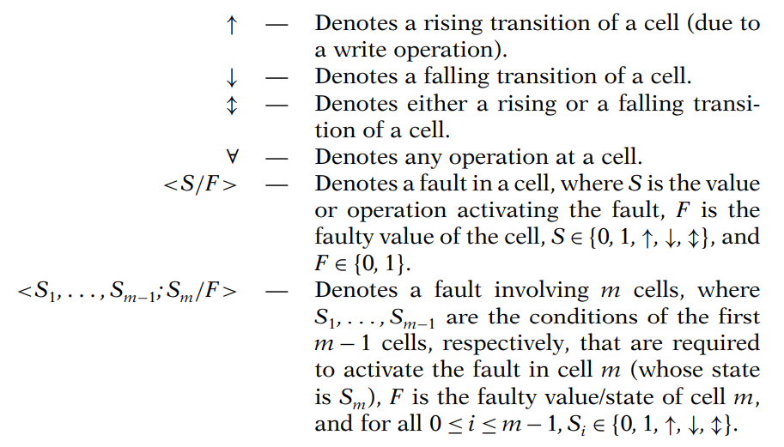
01 RAM Functional Fault Models and Test Algorithms
RAM Functional Fault Models
Faults in memory cell arrays, including:
Stuck-at fault (SAF)
Stuck-open fault (SOF)
Transition fault (TF)
Data retention fault: a cell fails to retain its logic value after a prespecified period of time
Coupling fault (CF):
Inversion coupling fault: a transition in one cell inverts the content of another
Idempotent coupling fault: a transition in one cell forces a constant value into another
State coupling fault: a coupled cell or line is forced to a certain value only if the coupling cell or line is in a given state
Read disturb fault: the cell value will flip when being read (repeatedly)

Slide 8
01 RAM Functional Fault Models and Test Algorithms
RAM Dynamic Fault
A static fault is one that has a static behaviour which does not change over time.
A dynamic fault, on the other hand, has a dynamic behavior that may change over time.
Recovery fault: it occurs when some part of the memory cannot recover fast enough from a previous state.
Sense amplifier recovery fault: the sense amplifier saturates after reading or writing a long string of 0’s or 1’s
Write recovery fault: a write followed by a read or write at a different location result in reading or writing at the same location due to slow address decoder.
Retention (refresh) fault: it occurs when the memory loses its content spontaneously, not caused by the read or write operation.
Imbalance fault: it occurs where the bit-line voltage imbalance causes read errors.

Slide 9
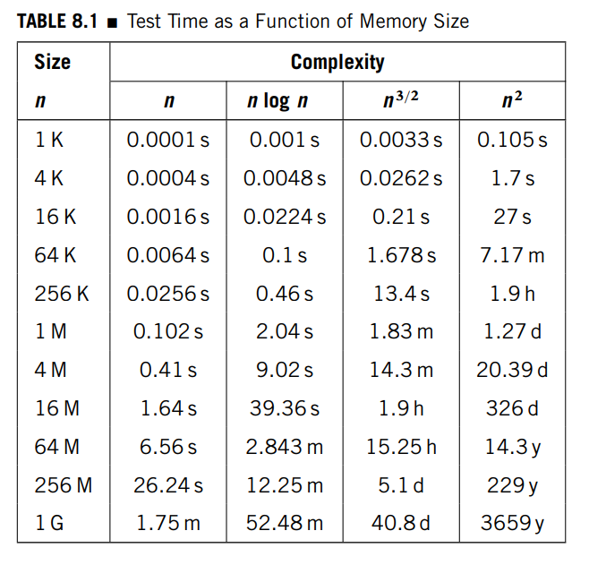
01 RAM Functional Fault Models and Test Algorithms
Functional Test Patterns and Algorithms
The comparison of test time for test algorithms with varying complexity.
The simplest (linear-time) tests that detect SAFs, TFs, and CFs are part of a family of tests called the Marches (i.e., the March tests).

Slide 10
01 RAM Functional Fault Models and Test Algorithms
March Tests
March element: a finite sequence of operations applied to every cell in the memory array before proceeding to the next cell. An operation can consist of:
writing a 0 into a cell (w0)
writing a 1 into a cell (w1)
reading an expected 0 from a cell (r0)
reading an expected 1 from a cell (r1)
A March test consists of a finite sequence of March elements.
Theorem: A test detects all AFs if it contains the March elements ⇑ (rx, …, wx’) and ⇓ (rx’,… , wx), and the memory is initialized to the proper value before each March element.

Slide 11
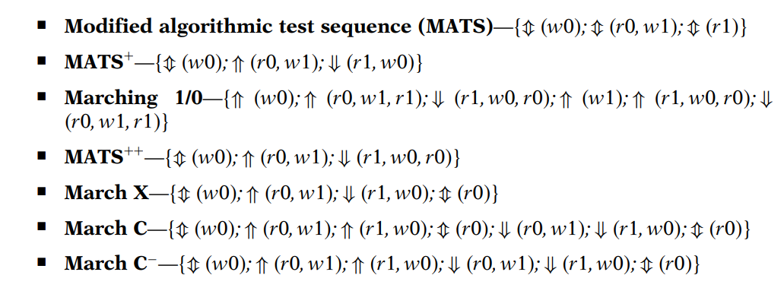
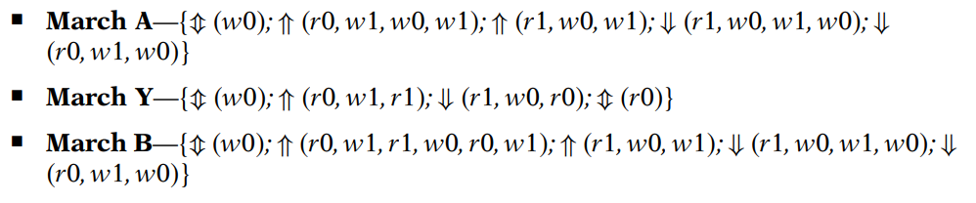
01 RAM Functional Fault Models and Test Algorithms
March Tests
Among all, March C− is known to completely detect SAFs, unlinked AFs, unlinked TFs, and CFs.

Slide 12
01 RAM Functional Fault Models and Test Algorithms
Comparison of RAM Test Patterns
The coverage of a March algorithm for its target faults is known by definition.
For example, March X was designed to test all AFs, SAFs, TFs, and CFins, so its coverage for these faults is 100%. If we want to know its coverage of CFids and CFsts, then analysis is required.
Because there are so many possible faults and test algorithms (including address sequences, read/write operations, and data patterns/backgrounds), determining the best algorithm that balances the cost and test coverage is difficult yet important.

Slide 13
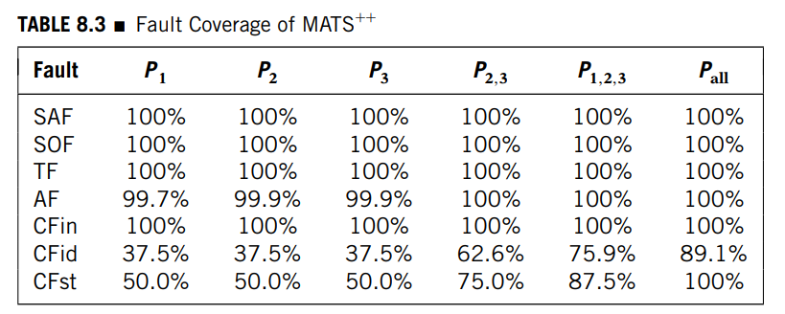
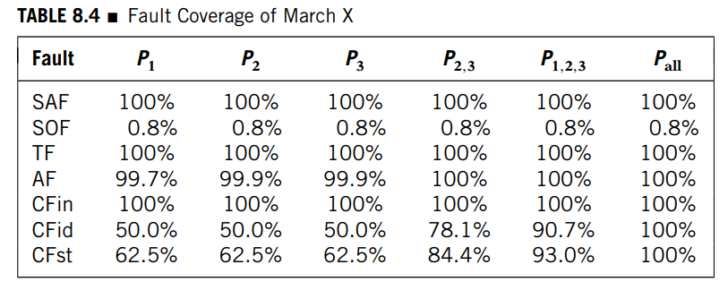
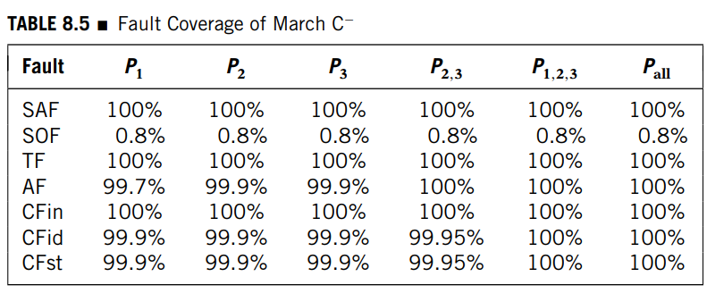
01 RAM Functional Fault Models and Test Algorithms
Comparison of RAM Test Patterns
We group faults into two classes:
single cell faults (e.g., stuck-at faults), which can be tested by an algorithm using any single data background since all cells are tested in the same way as for a bit-oriented.
faults involving two cells (e.g., coupling faults), which depend on the strength of the write operation and the coupling effect. If the coupling effect is stronger than the write operation, coupling faults inside a word have to be considered.

Slide 14
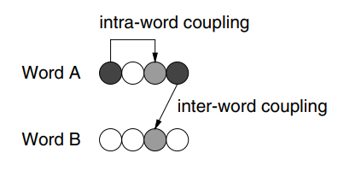
01 RAM Functional Fault Models and Test Algorithms
Word-Oriented Memory
For a word-oriented memory, we let N represent the number of data words in the memory, each word having w bits.
The read/write operations in the March tests are extended to reading and writing a word (called the background word, background pattern, or data background) instead of a bit at a time.
Possible problems: intra-word and inter-word coupling.

Slide 15
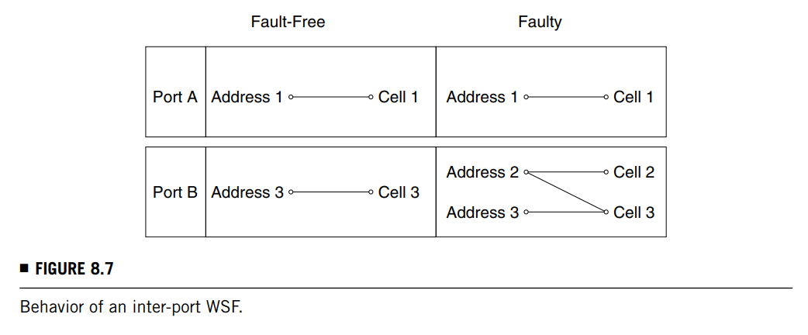
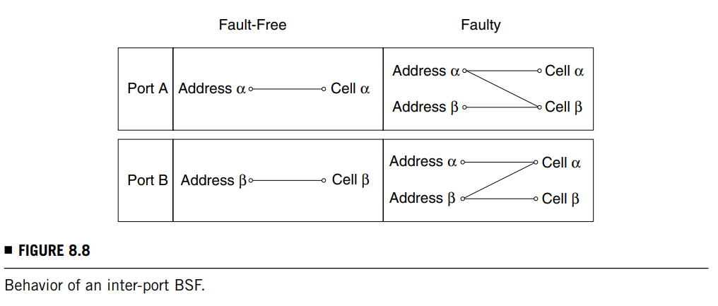
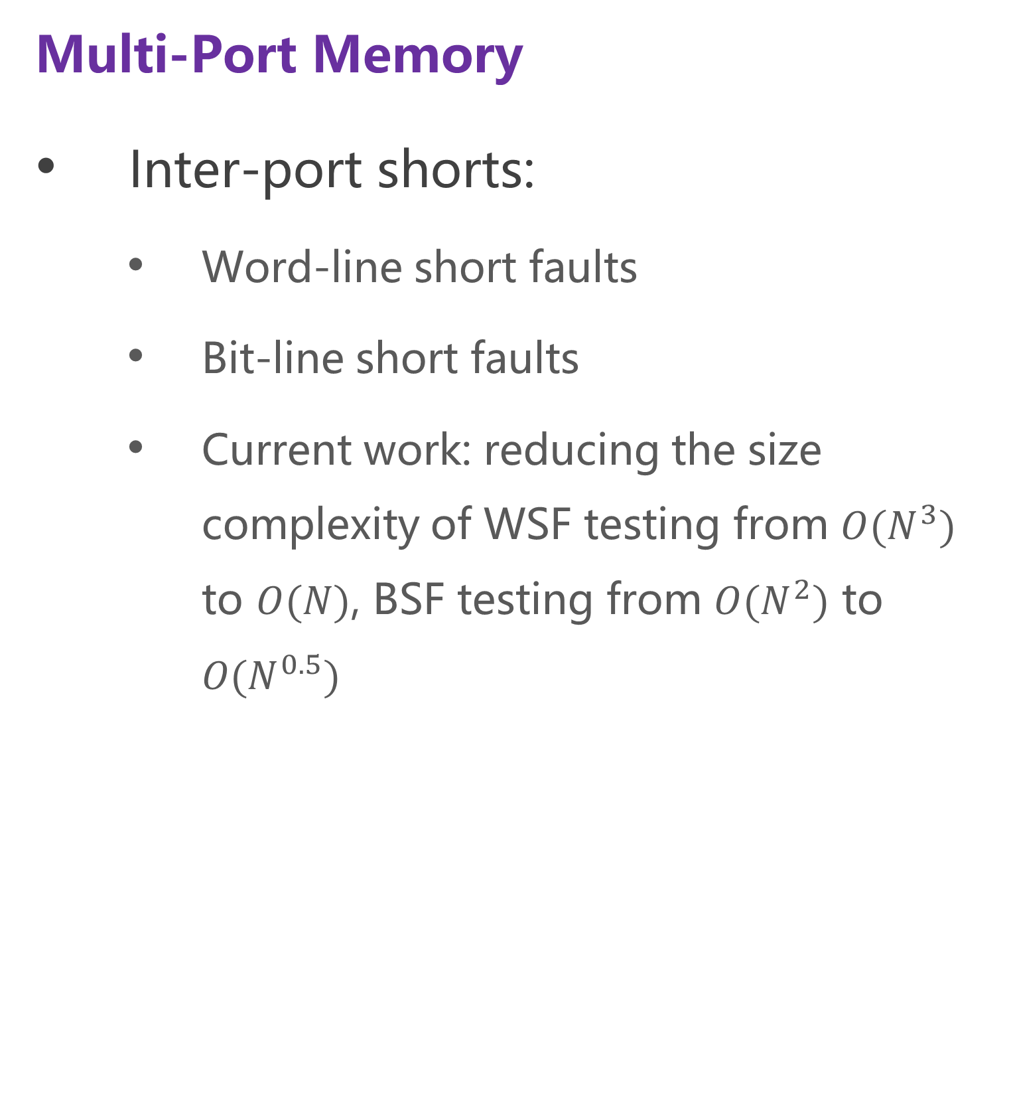
01 RAM Functional Fault Models and Test Algorithms
Multi-Port Memory
Inter-port shorts:
Word-line short faults
Bit-line short faults
Current work: reducing the size complexity of WSF testing from ${O(N}^{3})$ to $O(N)$, BSF testing from ${O(N}^{2})$ to ${O(N}^{0.5})$

Slide 16
RAM Fault Simulation and Test Algorithm Generation
02

Slide 17
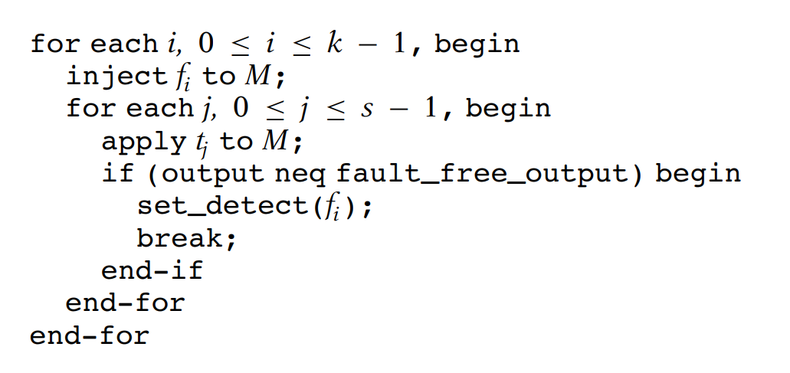
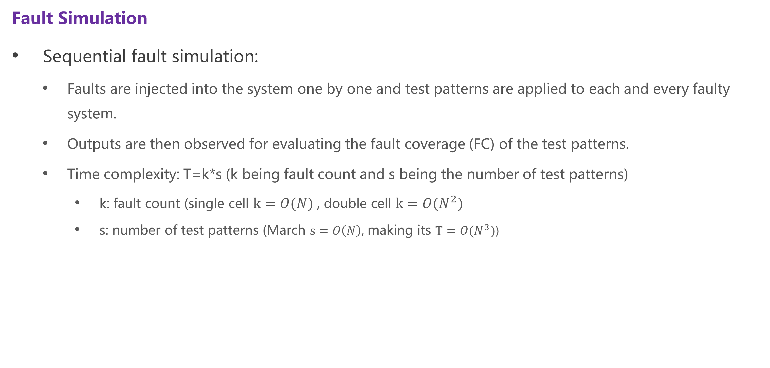
02 RAM Fault Simulation and Test Algorithm Generation
Fault Simulation
Sequential fault simulation:
Faults are injected into the system one by one and test patterns are applied to each and every faulty system.
Outputs are then observed for evaluating the fault coverage (FC) of the test patterns.
Time complexity: T=k*s (k being fault count and s being the number of test patterns)
k: fault count (single cell $k=O(N)$, double cell $k={O(N}^{2})$
s: number of test patterns (March $s=O\left(N\right)$, making its $T={O(N}^{3})$)

Slide 18
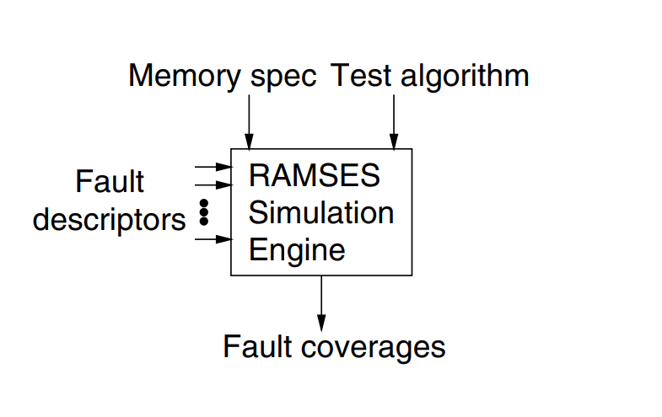
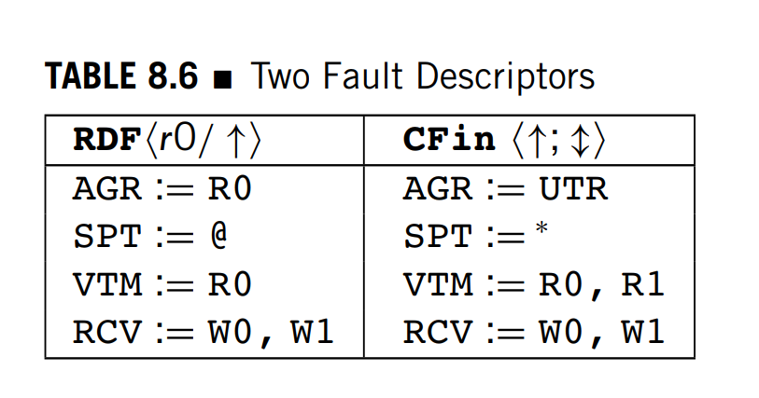
02 RAM Fault Simulation and Test Algorithm Generation
RAMSES
Fault descriptor:
Aggressor (AGR): an operation or condition that can activate the fault effect.
Victim (VTM): the operation affected by the fault (or to say the observable faulty output).
Suspect (SPT): the possible location of the aggressor.
it also indicates the possible victim location for each aggressor
Recoverer (RCV): the operation that can mask or recover the fault effect of the victim.

Slide 19
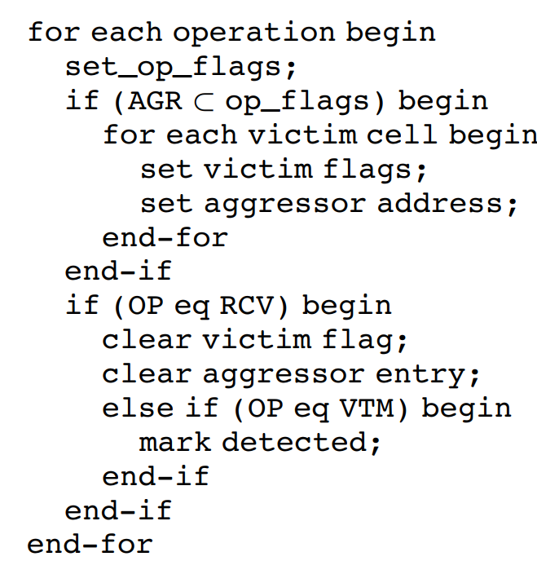
02 RAM Fault Simulation and Test Algorithm Generation
RAMSES
Procedure:
Set up operation flags
Check the attributes described in the fault descriptors for the fault activation and fault detection conditions.
If the AGR matches in the operation flags:
Put cell into the aggressor mode.
Set the victim flags for all possible victims.
Each victim should record the aggressor address.
If the RCV matches in the operation flags:
Clear the victim flag and the aggressor entry for the memory cell.
If the VTM matches in the operation flags:
The fault effect is observable and it is marked as detected.

Slide 20
02 RAM Fault Simulation and Test Algorithm Generation
RAMSES
For word-oriented memories, the relative strength of the write operation and the coupling effect should be defined first.
For multi-port memories, additional operation flags are required for inter-port faults. Port specification also is necessary for the operation flags.

Slide 21
02 RAM Fault Simulation and Test Algorithm Generation
Test Algorithm Generation by Simulation (TAGS)
March template: a sequence of read/Write operations similar to a March test, but without the explicit specification of address sequences and data backgrounds.
e.g. (w)(rw)(rwr) is a march template.

Slide 22
02 RAM Fault Simulation and Test Algorithm Generation
Test Algorithm Generation by Simulation (TAGS)
Test generation procedure of TAGS:
Initialize the test length as 1N.
Let the template set contain a single template t = (w).
Increase the test length by 1N.
For each template t in the template set:
add a read/write operation to t using one of the generation options
repeat the step for all possible cases to form a new template set, except when any of the filtering conditions is true.
A series of March tests is generated by assigning address orders in various combinations to each template in the set, together with consistent data backgrounds.
When the address order for a stand-alone read or write can be either ⇑ or ⇓, we use ⇑ by default.
Simulate the resulting March tests using RAMSES.
…

Slide 23
02 RAM Fault Simulation and Test Algorithm Generation
Test Algorithm Generation by Simulation (TAGS)
Test generation procedure of TAGS:
…
Drop the tests that have no FC improvement over tests in the previous iteration, or if the improvement is completely covered by another test in the current iteration.
Repeat steps 3 to 6 using the new template set until the given fault set is 100% covered or the test length limit is reached.

Slide 24
Memory Built-In Self-Test
03

Slide 25
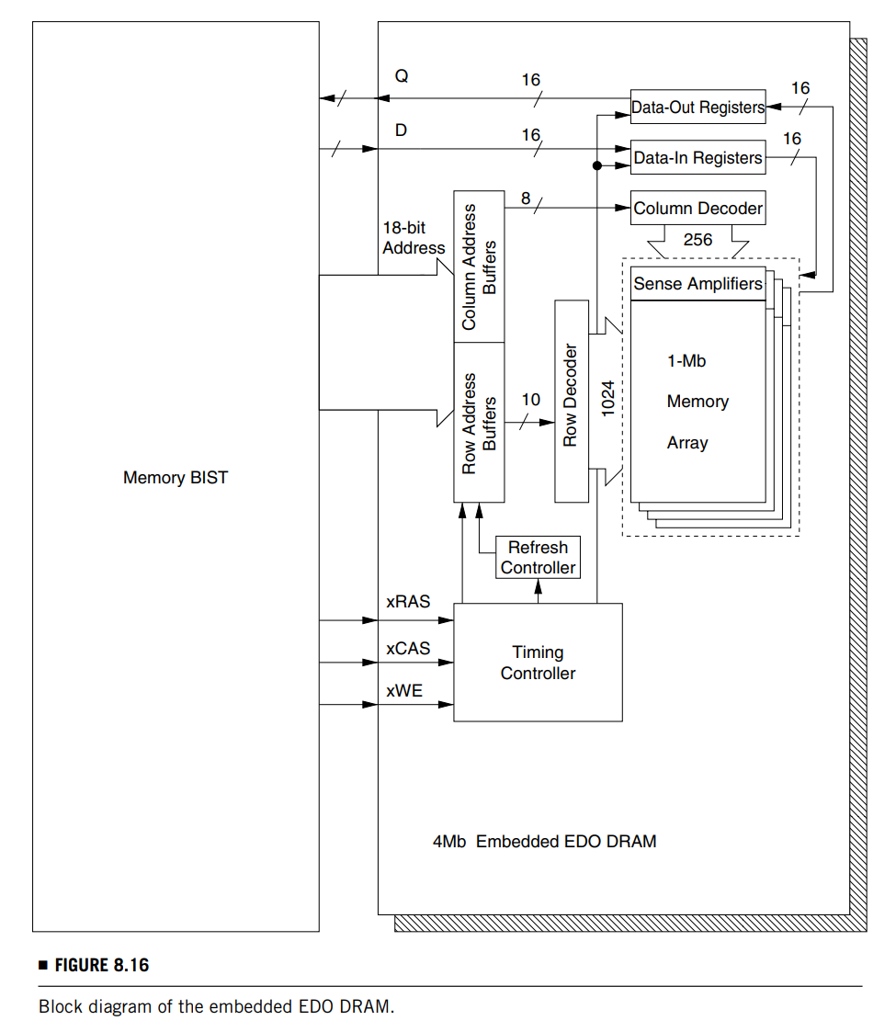
03 Memory Built-In Self-Test
RAM Specification and BIST Design Strategy
One of the challenges in memory BIST is that the asynchronous memory core (traditional RAMs are asynchronous) is to be tested by the synchronous BIST logic.
Therefore, once the conversion is done and fixed in a BIST design, the clock period should be determined with care to avoid violation of the timing specifications of the EDRAM.

Slide 26
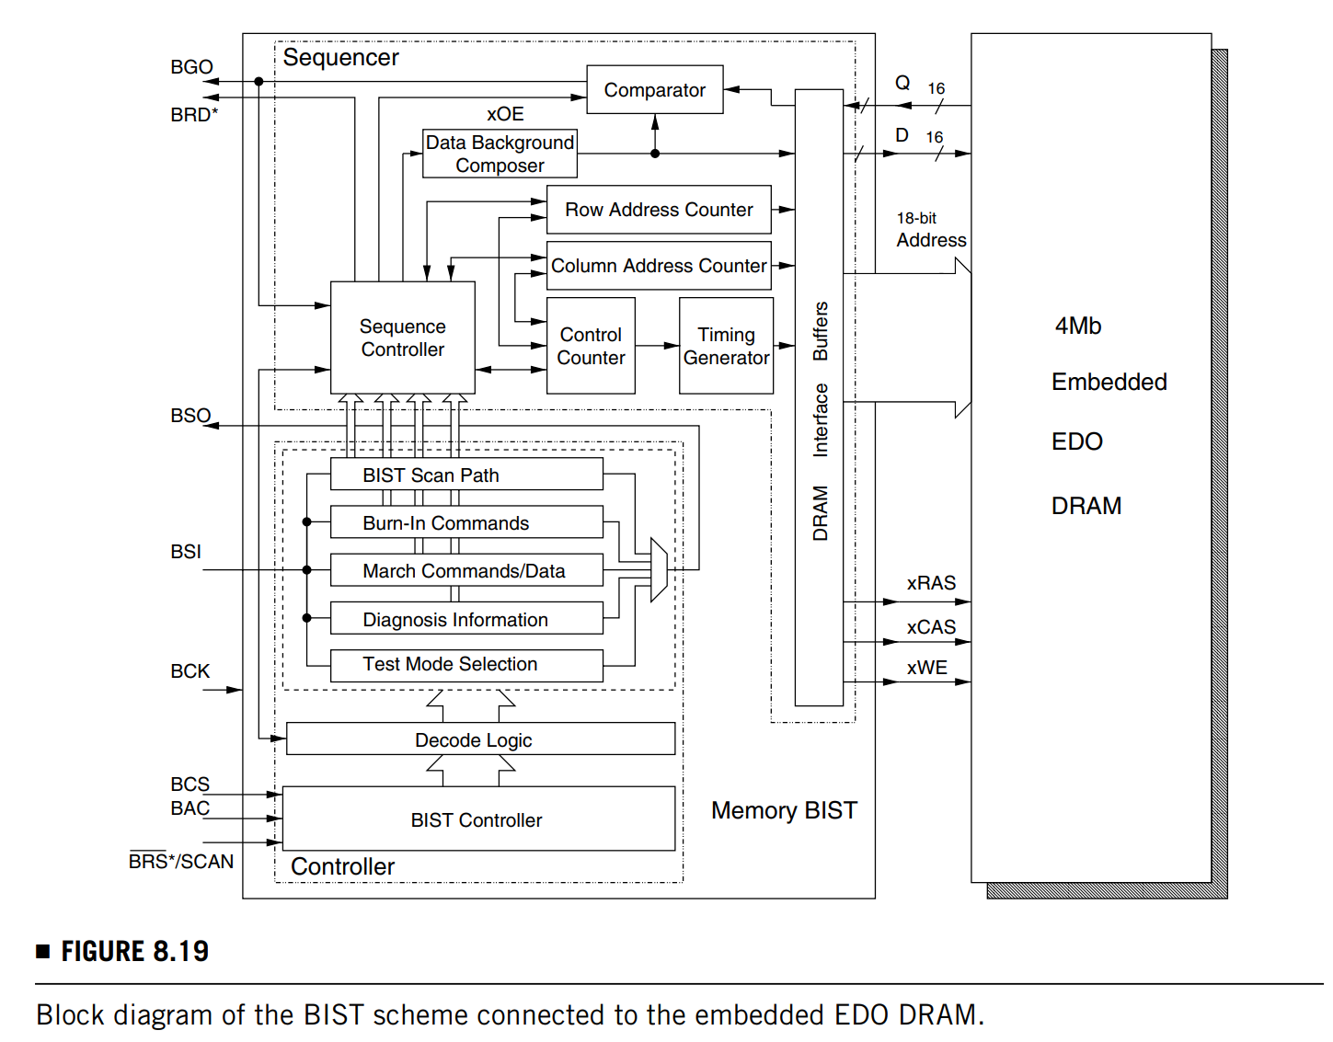
03 Memory Built-In Self-Test
BIST Architectures and Functions
The BIST logic is activated by the BIST activation control (BAC) input; that is, the EDRAM is in normal mode when BAC = 0, and it is in BIST mode when BAC = 1.
The BIST controller is a finite-state machine (FSM), whose state transition is controlled by the BIST control selection (BCS) input.
Test patterns and commands can be shifted in from the BIST scan-in (BSI) input and results can be shifted out from the BIST scan-out (BSO) output.

Slide 27
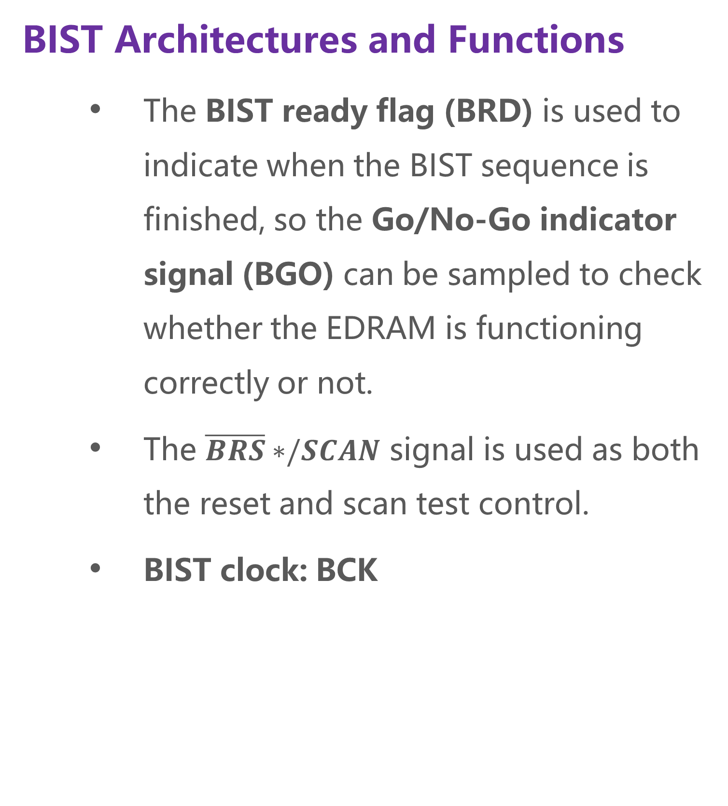
03 Memory Built-In Self-Test
BIST Architectures and Functions
The BIST ready flag (BRD) is used to indicate when the BIST sequence is finished, so the Go/No-Go indicator signal (BGO) can be sampled to check whether the EDRAM is functioning correctly or not.
The $\overline{BRS}∗/SCAN$ signal is used as both the reset and scan test control.
BIST clock: BCK

Slide 28
03 Memory Built-In Self-Test
BIST Architectures and Functions
Test modes:
Scan test mode: for testing and verifying the BIST logic
Memory BIST mode: for functional testing of the DRAM using March-based algorithms.
Diagnosis may also be supported in this mode.
Retention faults can be tested in this mode or in a separate test mode.
Burn-in (BI) mode: for stress testing of the DRAM to screen out unreliable parts that may fail in their infancy.
Timing fault test mode: for testing some critical timing faults by running the BIST clock at an appropriate speed.

Slide 29
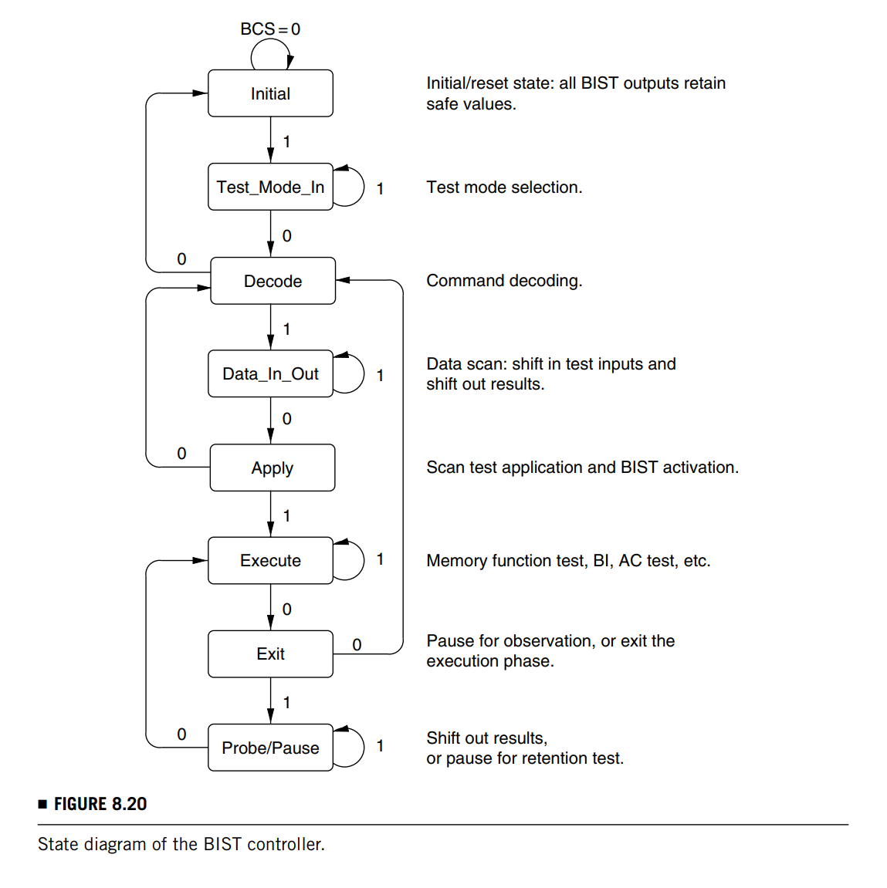
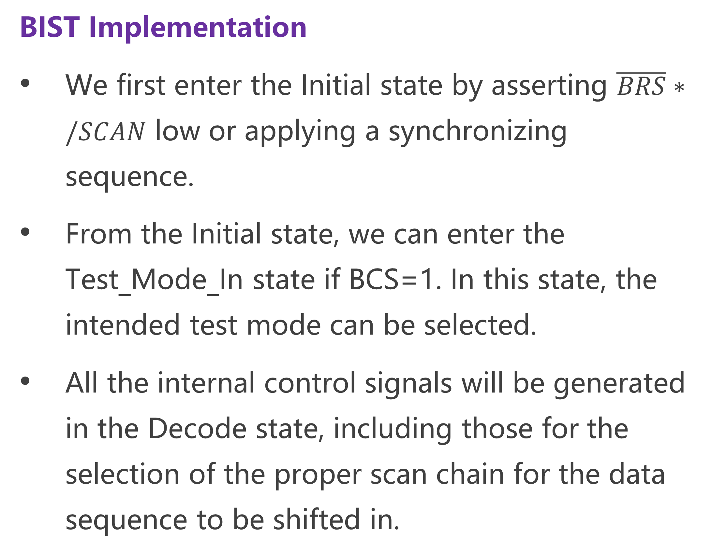
03 Memory Built-In Self-Test
BIST Implementation
We first enter the Initial state by asserting $\overline{BRS}∗/SCAN$ low or applying a synchronizing sequence.
From the Initial state, we can enter the Test_Mode_In state if BCS=1. In this state, the intended test mode can be selected.
All the internal control signals will be generated in the Decode state, including those for the selection of the proper scan chain for the data sequence to be shifted in.

Slide 30
03 Memory Built-In Self-Test
BIST Implementation
User-specified parameters and the test algorithm are shifted in during the Data_In_Out state.
Other test modes are performed in the Execute state.
For memory core testing and diagnosis, we enter the bottom loop, which contains the Execute, Exit, and Probe/Pause states, and collect the error information in the Probe/Pause state.

Slide 31
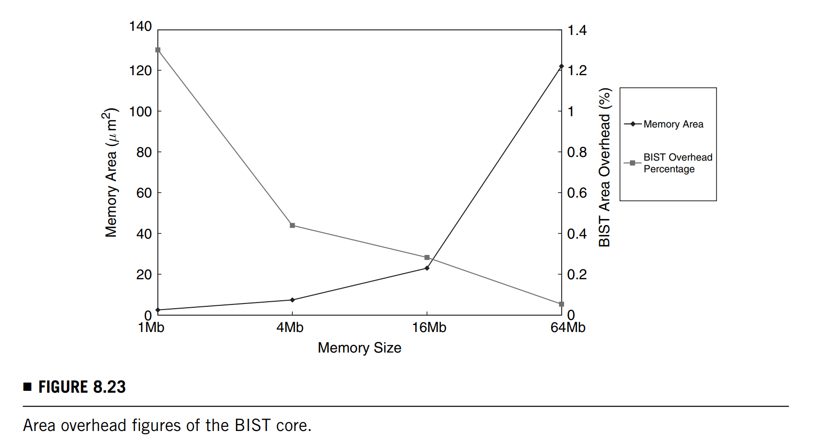
03 Memory Built-In Self-Test
BIST Implementation
The sequencer design is counter based. If the memory size increases, only the lengths of the row address counter and column address counter and the size of the comparator will increase.
Only one additional bit is required for an address counter when the memory size is doubled, so the hardware overhead is low.

Slide 32
Thanks for listening!
Haochen Ding

